Slide 1
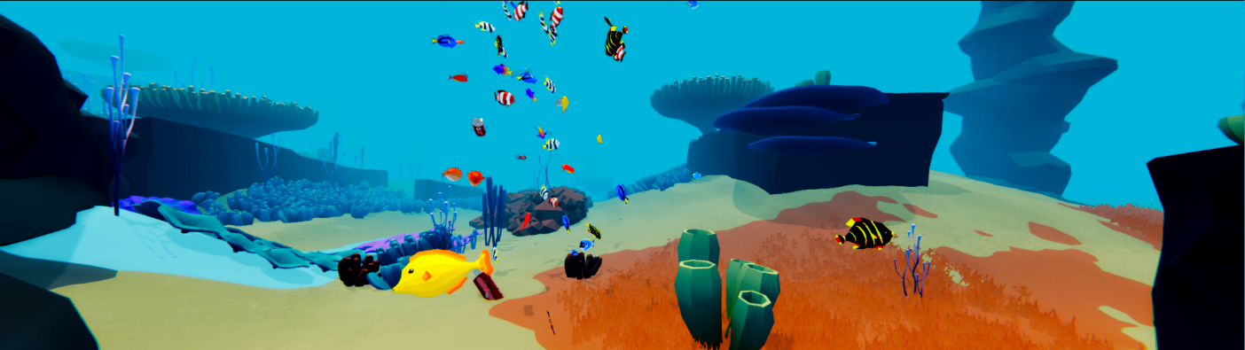
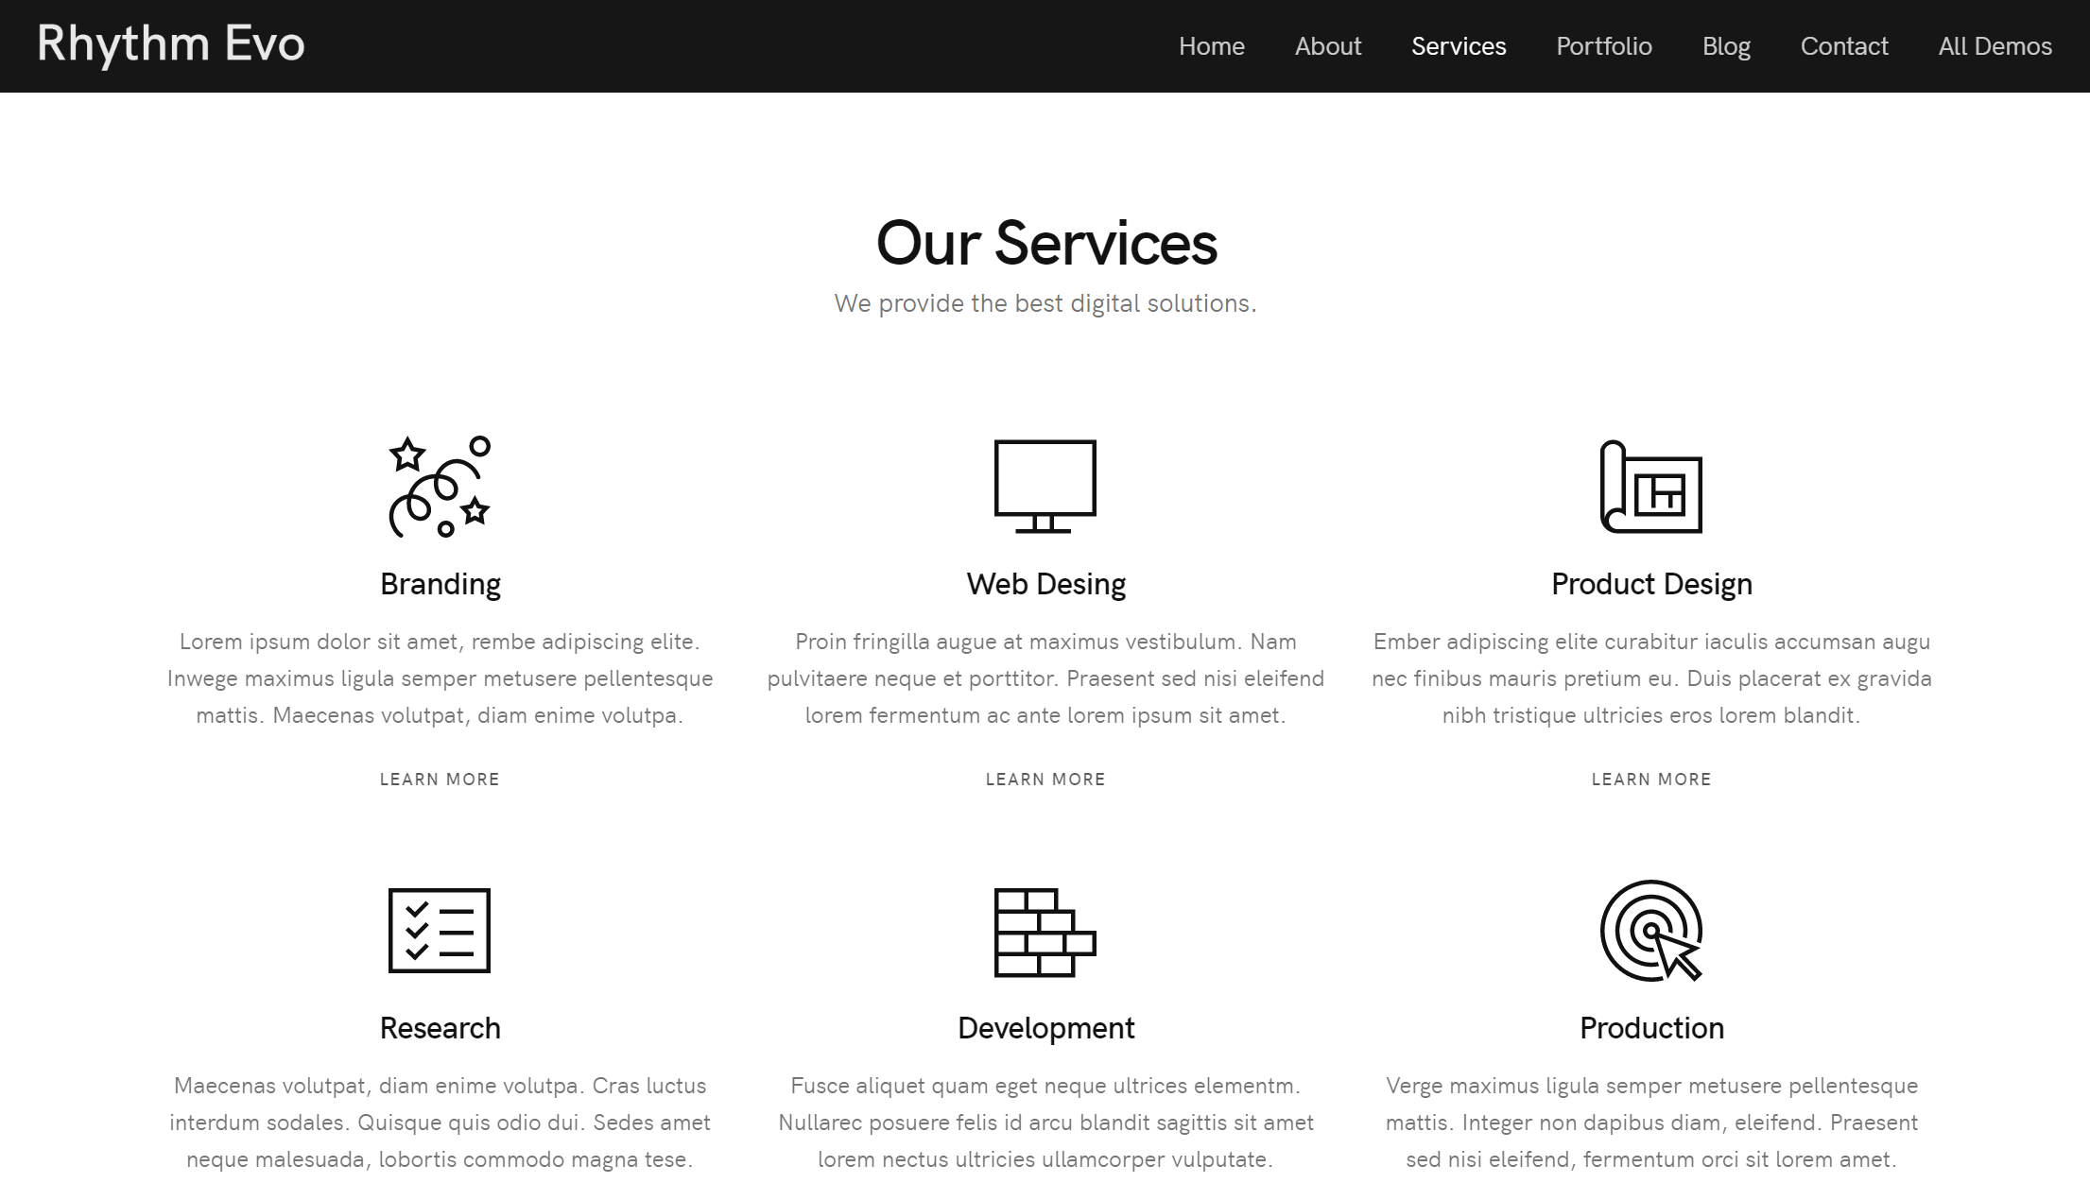
#03, Our Campaign – 01
디자인
Save the fish
Home About Us Our Campaign Blog Contact Donation Privacy Policy
Coral Reef fish | Distant Lands
Screen Ratio 32 : 9

